Slide 1
Cloud based online auction web application
Introductions of online auction and the application design
Yun Shu (Felix)
Full-Stack .NET Developer

Slide 2
Table of contents
Introduction of online auction
English Auction (Real Time Bidding)
Free Bidding and Time-limited bidding
Reserve Auction
Sealed-bid
Vickrey auction
New Ideas for Sealed-bid
Architecture Design
Legacy architecture (traditional distribution system)
Cloud-based architecture (Akka.NET and SignalR)
Application Design
Domain model design(DDD)
Repository pattern and Dependency Injection
NoSQL Database vs Relational Database
Data Transmission
Responsive UI and Single Page Application
Main Issues of The Online Auction System
Online Fraud and The Third Part Authorization

Slide 3
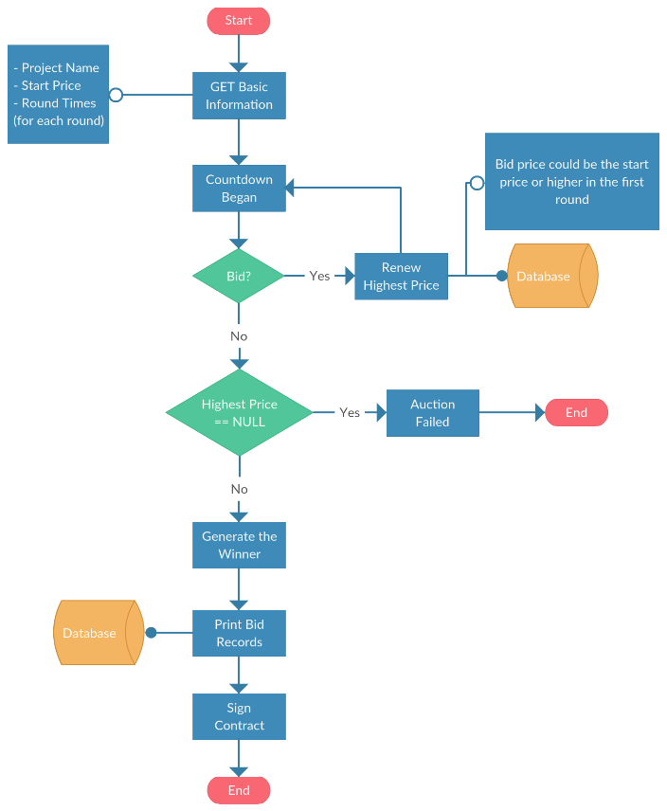
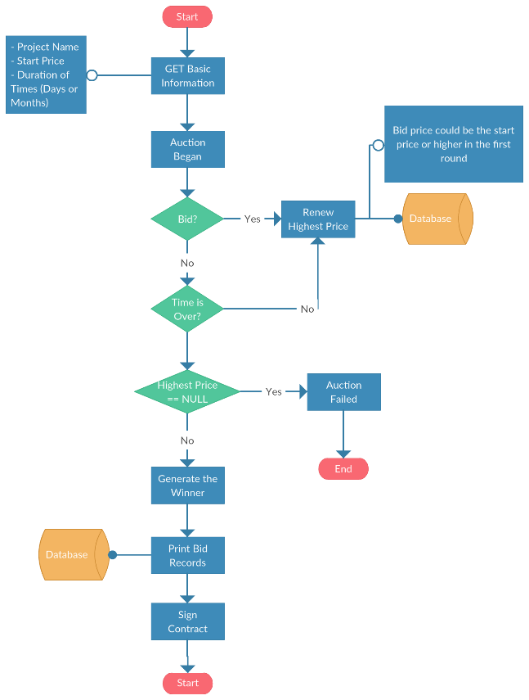
English auction
Time-limited Bidding
Free Time Bidding

Slide 4

Real-time bidding combination

Slide 5
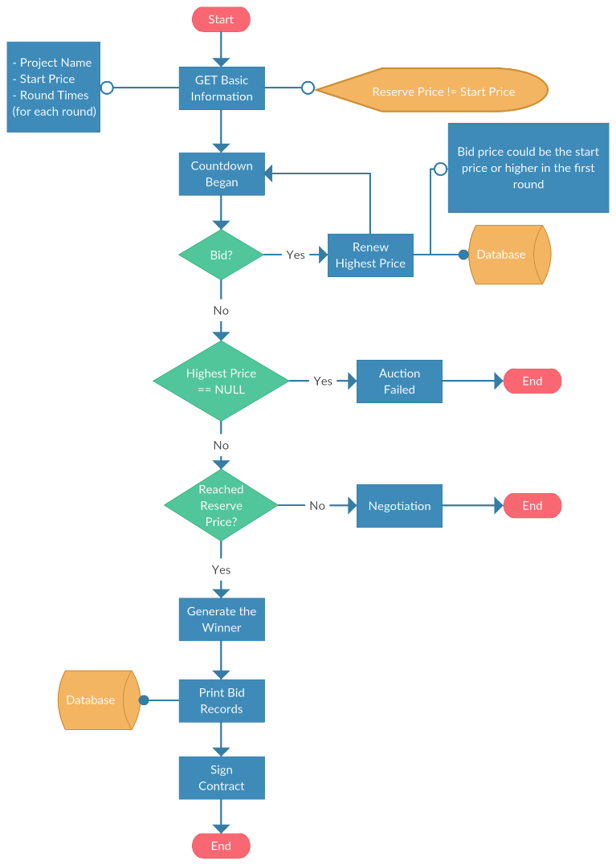
Reserve auction
Seller can set an reserve price before the auction begin

Slide 6
Sealed bidding
One times Offer
Vickrey auction
each buyer seals offer and price in an envelope, and then submits to the auctioneer.
After reaching the deadline, the auctioneer opens all envelope and claims the result.
The bidder wins with the highest price.
In this case, the winner only need to pay the second highest bid price.
The idea here is to motivate buyers to place a higher price.
However, Vickrey auction is rarely utilized in modern online auction business.

Slide 7
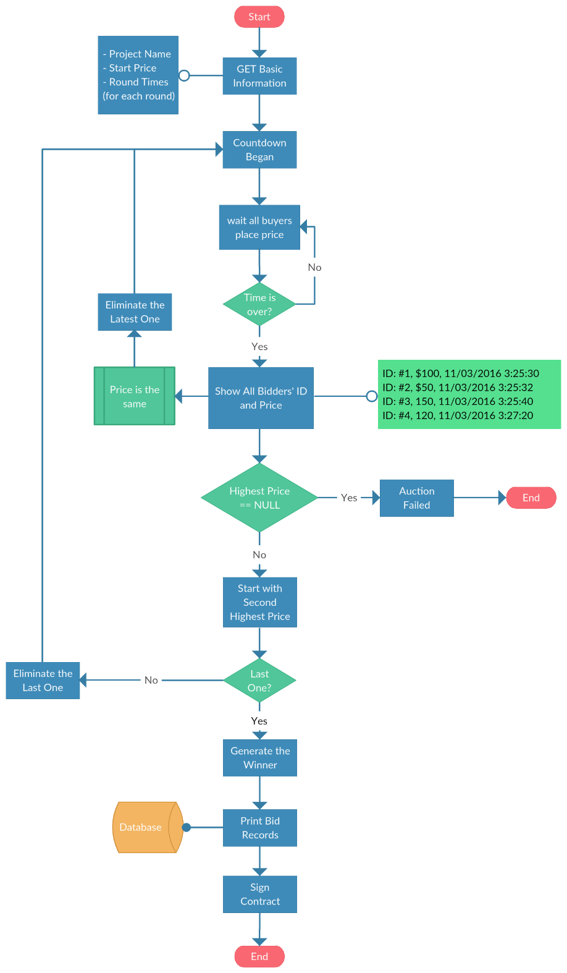
New idea for sealed bidding
Turn-based mechanism
inferior eliminated mechanism
Second Highest Award

Slide 8
The legacy architecture
First bullet point here
Second bullet point here
Third bullet point here
Group A
Task 1
Task 2
Group B
Task 1
Task 2
Group C
Task 1

